Slide 1

A Cassandra-Based Framework for Secure and Scalable Cybersecurity Data Management
This presentation introduces SCADS (Secure and Consistent Analytics on Distributed Storage), a conceptual framework leveraging Apache Cassandra for scalable, secure, and high-performance cybersecurity data management. SCADS addresses the challenges of handling massive volumes of security data in real-time, supporting applications like SIEM(Security Information and Event Management), threat hunting, and anomaly detection.
By Daniyal Haider

Slide 2

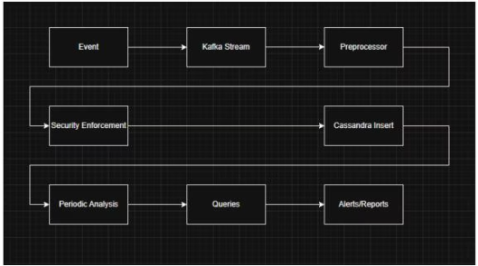
Challenges in Cybersecurity Data Management
Data Volume & Velocity
Limitations of Traditional Databases
Need for Secure, Distributed Systems
Enterprises generate petabytes of logs and telemetry data, requiring real-time ingestion and analysis.
Relational databases struggle with scalability and real-time demands of cybersecurity analytics.
Systems must ensure availability, fault tolerance, and enforce security policies across distributed environments.

Slide 3
SCADS Framework Overview
Core Idea
Key Components
SCADS integrates Cassandra's distributed storage with a secure data pipeline for scalable cybersecurity data management.
Data Ingestion Layer (Kafka/NiFi)
Security Enforcement Module (encryption, authentication, Role-Based Access Control (RBAC) )
Designed for cloud, hybrid, and edge deployments, it supports high ingestion rates and secure querying.
Distributed Storage (Cassandra)
Analytics Interface (Spark/Presto)
Adaptive Scaling & Resilience

Slide 4

SCADS Write Operation Algorithm
1
Authenticate & Encrypt
2
Normalize & Enrich
Verify user/session and encrypt sensitive fields of security events.
Process data for consistency and add contextual information.
3
Partition & Insert
4
Confirm Write
Generate partition key and insert data into Cassandra with desired consistency.
Ensure data is stored reliably with best consistency level.

Slide 5

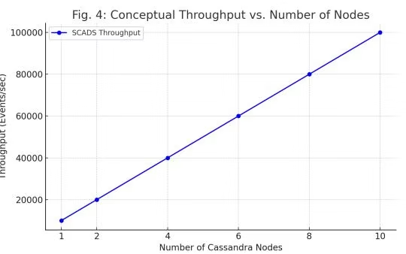
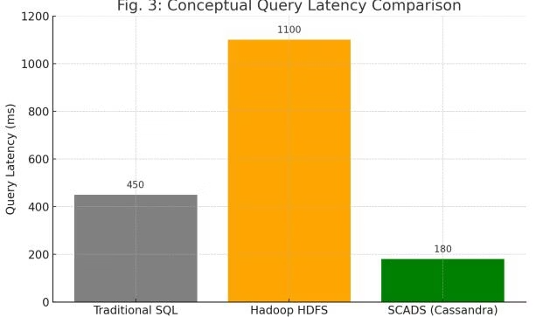
Performance Evaluation: Throughput & Latency
System Type
Ingest Rate (events/sec)
Latency (ms)
Scalability
Security
SQL DB
5K
300–500
Low
Basic
Hadoop
20K
~1000
Medium
Medium
SCADS
~100K
<200
High
High

Slide 6

Limitations and Future Directions
Limitations
Complex configuration and tuning required
Not ideal for complex relational queries without external tools
Encrypted data analytics still limited
Future Work
Integrate AI pipelines for enhanced threat detection
Support federated learning for distributed cybersecurity
Enable cross-cluster security audits for multi-tenant setups
Improve explainability in data models for forensic analysis

Slide 7

Conclusion: Advancing Cybersecurity Data Management
SCADS presents a secure, scalable, and fault-tolerant framework leveraging Apache Cassandra for modern cybersecurity data management. It addresses limitations of traditional systems by enabling high-throughput ingestion, real-time analytics, and robust security controls.
This conceptual framework guides the development of resilient cybersecurity infrastructures suitable for enterprise and government environments facing massive data and security challenges.

